Slide 1

MQTT PROTOCOL
Lecturer: Dr. Bui Ha Duc
Dept. of Mechatronics
Email: ducbh@hcmute.edu.vn

Slide 2
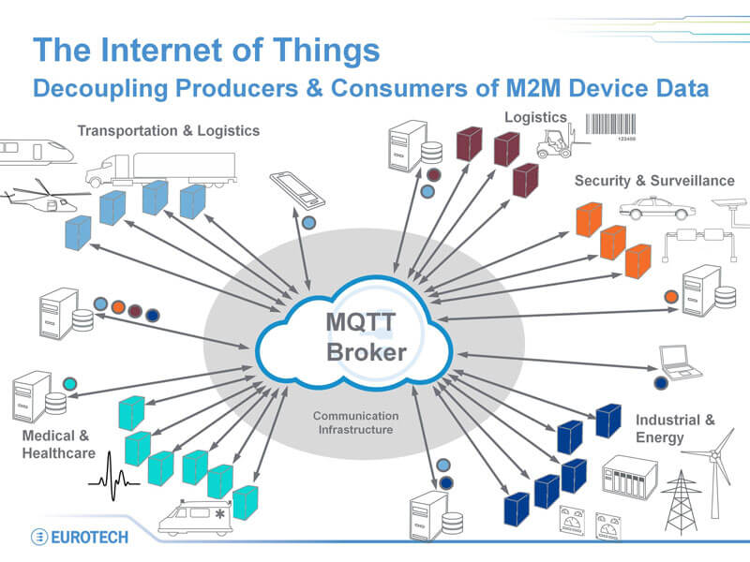

Slide 3
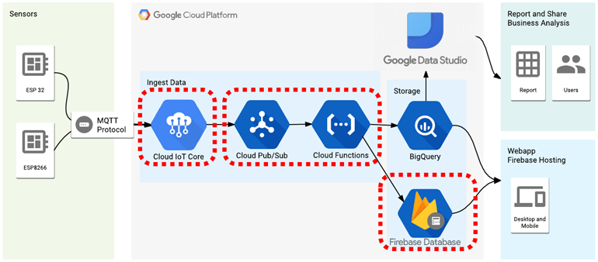
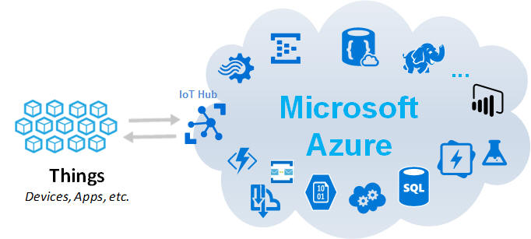

Slide 4
Introduction to MQTT
MQTT - Message Queuing Telemetry Transport
MQTT was invented in 1999 by IBM as a Client Server publish/subscribe messaging transport protocol
Advantages of MQTT:
Lightweight
Simple
Easy to implement
MQTT is faster than HTTP’s.
IBM used it internally, only release after version 3.1 in 2012.
The current version is MQTT 5, released in 2019
Notes:
IBM used it internally, only release after version 3.1 in 2012.
The current version is MQTT 5 released in 2019

Slide 5
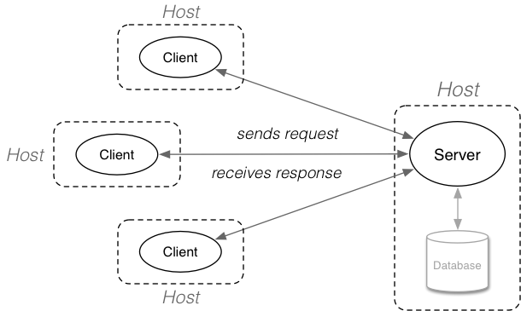
Client-Server Model
Traditional Client-Server architechture
Notes:
clients communicates directly with an endpoint/host
Suitable for complex data packet, over-kill for simple data transmission. Like use truck as a taxi

Slide 6
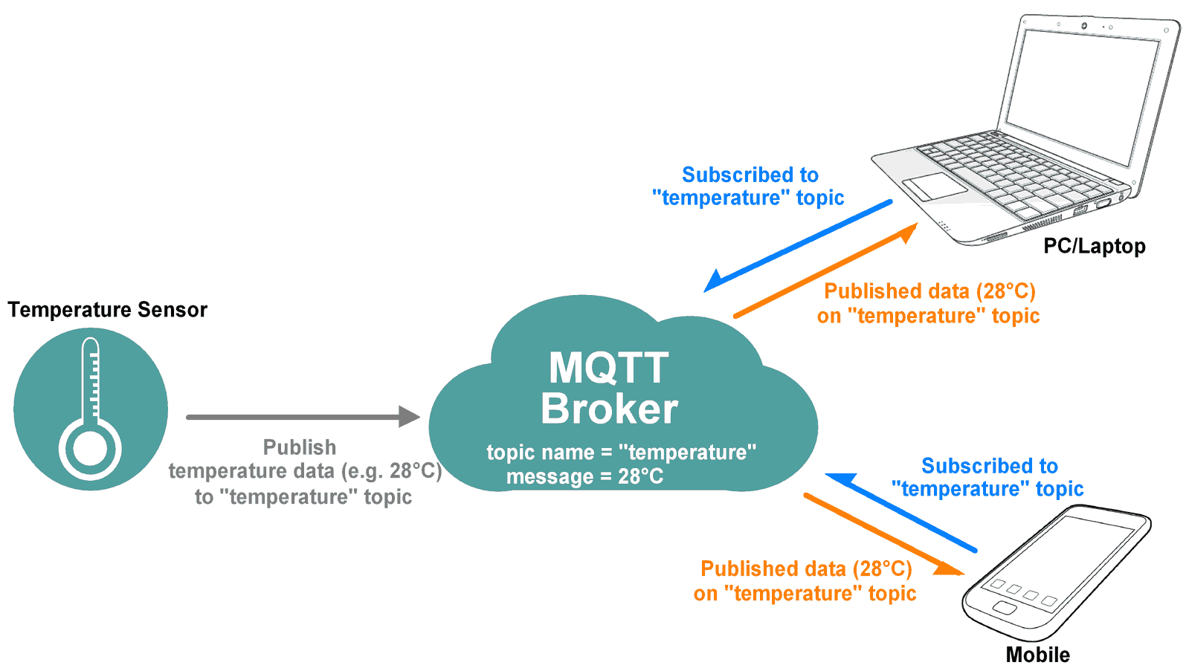
Publish/subscribe Model
Publish/Subscribe Model
Broker (address ip:port)
filter all incoming messages
distribute them correctly to subscribers
Publisher - clients that send messages
Subscribers - clients that receive the messages
never contact each other directly
Notes:
they are not even aware that the other exists
Data is only stored for a short time

Slide 7
Publish/subscribe Model
Publish/subscribe model has 3 features
Publisher and subscriber do not need to know each other (for example, no exchange of IP address and port).
Publisher and subscriber do not need to run at the same time.
Operations on both components do not need to be interrupted during publishing or receiving.
MQTT uses topic filtering of messages
Topic is an UTF-8 string that the broker uses to filter messages for each connected client
Topic filters can contain wildcards: +, #

Slide 8


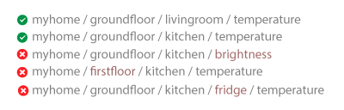

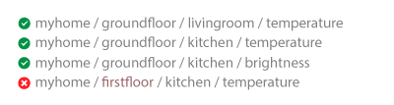
MQTT Topic
Topic consists of one or more topic levels, separated by “/”
A subscriber can use wild card to subscribe to multiple topic simultaneously

Slide 9
MQTT Message
MQTT only has several types of message:
CONNECT: Used for clients to send connection requests to the broker
PUBLISH: Used by the client to publish messages to the broker
(UN)SUBSCRIBE: Used by the client to receive/stop receiving messages from the broker
ACKNOWLEDGEMENT: Used by receiver to confirm an action
CONNACK: Xác nhận kết nối.
PUBACK: Xác nhận rằng thông điệp PUBLISH đã được nhận.
PUBREC: Xác nhận rằng thông điệp PUBLISH đã được nhận (trong bước đầu của quá trình xác nhận QoS 2)
SUBACK: Xác nhận việc đăng ký (subscribe)
UNSUBACK : Xác nhận việc hủy đăng ký (unsubscribe) khỏi một chủ đề

Slide 10
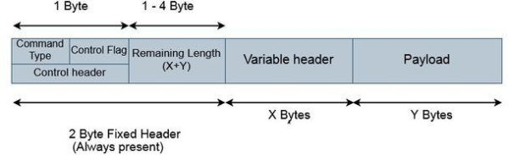
MQTT Message
MQTT Message format:
(refer to this link for more detail: https://openlabpro.com/guide/mqtt-packet-format/ )

Slide 11
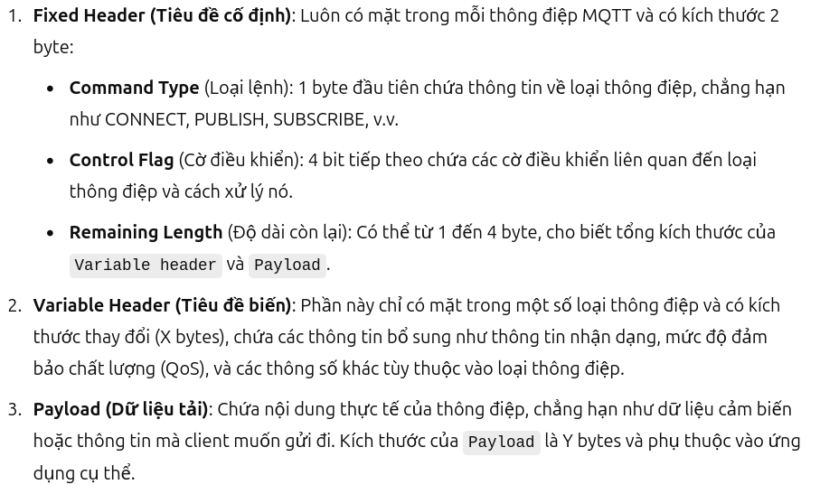
MQTT Message
MQTT Message format:

Slide 12
MQTT Message flow
Client 1
Broker
CONNECT
CONNACK
PUBLISH
Client 2
PUBREC
SUBSCRIBE
SUBACK
Client 3
PUBLISH
PUBREC
UNSUBSCRIBE
UNSUBACK
MQTT is a command protocol, each command will be response by the receiver

Slide 13
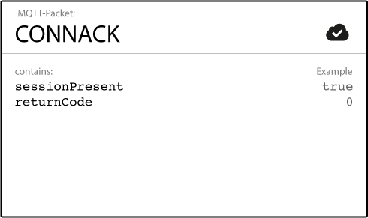
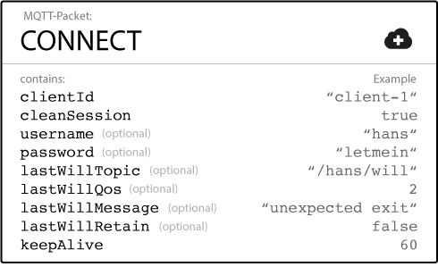
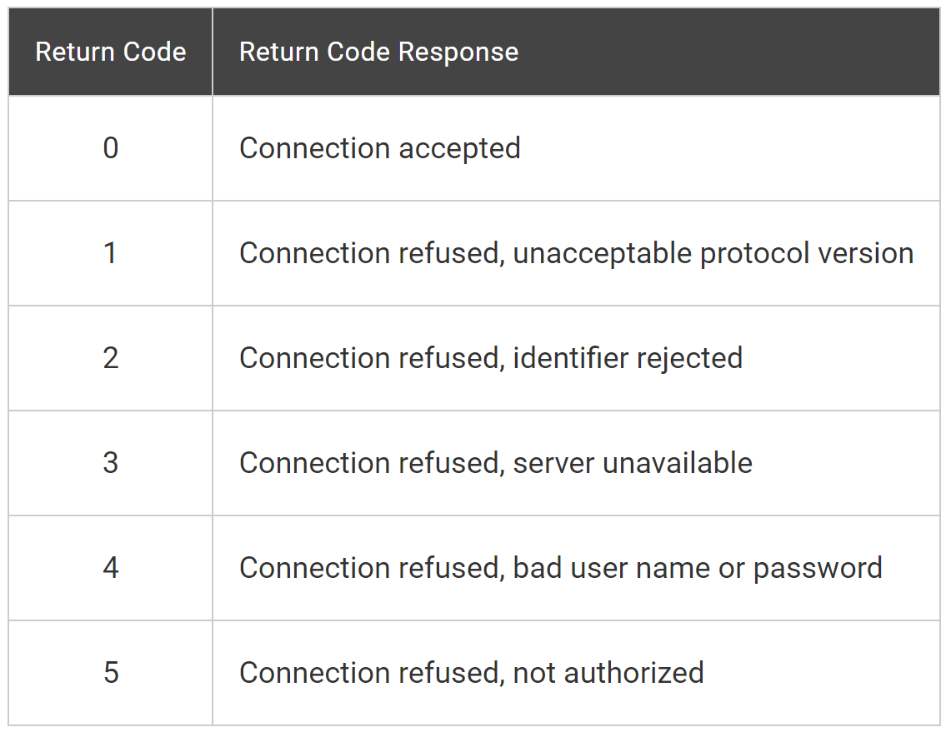
MQTT Message flow - CONNECT
Client 1
Broker
Connect message is sent by the client to the broker to initiate a connection
Server to client, connect acknowledgment
CONNECT
CONNACK
SUBSCRIBE
SUBACK
UNSUBSCRIBE
UNSUBACK
(refer to this link for more detail: https://www.hivemq.com/blog/mqtt-essentials-part-3-client-broker-connection-establishment/ )
Notes:
Both publishers and subscribers are MQTT clients.
The client identifier (ClientId) identifies each MQTT client that connects to an MQTT broker. The broker uses the ClientId to identify the client and the current state of the client.Therefore, this Id should be unique per client and broker. In MQTT 3.1.1 you can send an empty ClientId, if you don’t need a state to be held by the broker. The empty ClientId results in a connection without any state. In this case, the clean session flag must be set to true or the broker will reject the connection.
The clean session flag tells the broker whether the client wants to establish a persistent session or not. In a persistent session (CleanSession = false), the broker stores all subscriptions for the client and all missed messages for the client that subscribed with a Quality of Service (QoS) level 1 or 2. If the session is not persistent (CleanSession = true), the broker does not store anything for the client and purges all information from any previous persistent session.

Slide 14
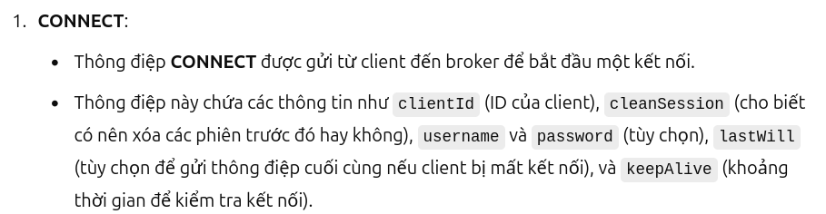
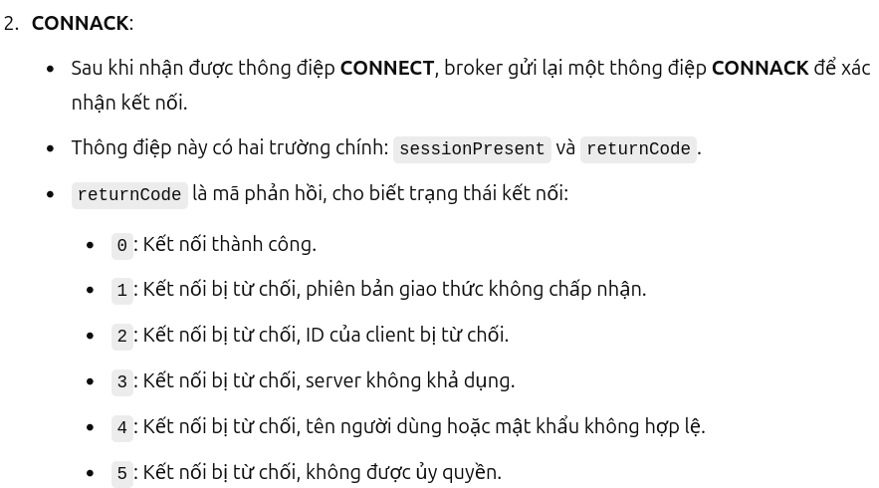
Connect message is sent by the client to the broker to initiate a connection
(refer to this link for more detail: https://www.hivemq.com/blog/mqtt-essentials-part-3-client-broker-connection-establishment/ )
Notes:
Both publishers and subscribers are MQTT clients.
The client identifier (ClientId) identifies each MQTT client that connects to an MQTT broker. The broker uses the ClientId to identify the client and the current state of the client.Therefore, this Id should be unique per client and broker. In MQTT 3.1.1 you can send an empty ClientId, if you don’t need a state to be held by the broker. The empty ClientId results in a connection without any state. In this case, the clean session flag must be set to true or the broker will reject the connection.
The clean session flag tells the broker whether the client wants to establish a persistent session or not. In a persistent session (CleanSession = false), the broker stores all subscriptions for the client and all missed messages for the client that subscribed with a Quality of Service (QoS) level 1 or 2. If the session is not persistent (CleanSession = true), the broker does not store anything for the client and purges all information from any previous persistent session.

Slide 15
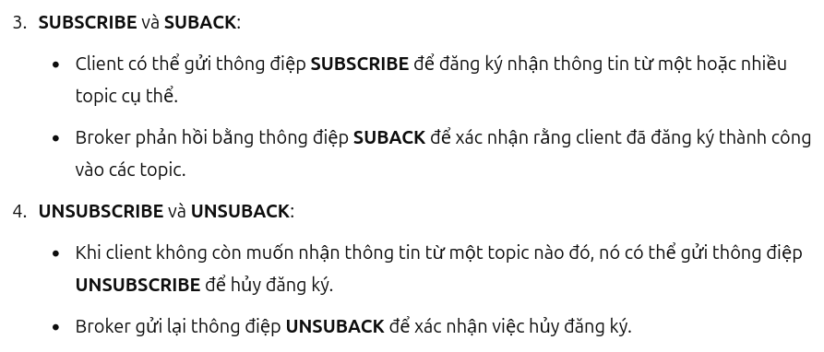
Connect message is sent by the client to the broker to initiate a connection
(refer to this link for more detail: https://www.hivemq.com/blog/mqtt-essentials-part-3-client-broker-connection-establishment/ )
Notes:
Both publishers and subscribers are MQTT clients.
The client identifier (ClientId) identifies each MQTT client that connects to an MQTT broker. The broker uses the ClientId to identify the client and the current state of the client.Therefore, this Id should be unique per client and broker. In MQTT 3.1.1 you can send an empty ClientId, if you don’t need a state to be held by the broker. The empty ClientId results in a connection without any state. In this case, the clean session flag must be set to true or the broker will reject the connection.
The clean session flag tells the broker whether the client wants to establish a persistent session or not. In a persistent session (CleanSession = false), the broker stores all subscriptions for the client and all missed messages for the client that subscribed with a Quality of Service (QoS) level 1 or 2. If the session is not persistent (CleanSession = true), the broker does not store anything for the client and purges all information from any previous persistent session.

Slide 16
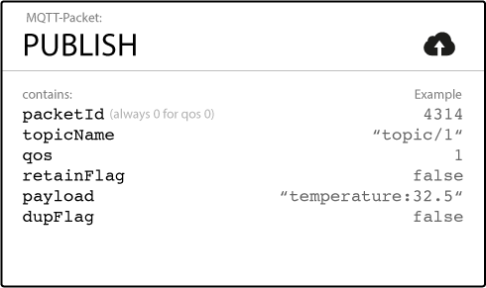
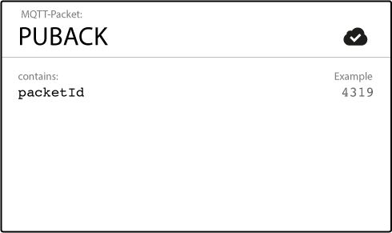

MQTT Message flow - PUBLISH
Broker
Client 2
PUBLISH
PUBACK
Client 3
PUBLISH
PUBREC

Slide 17
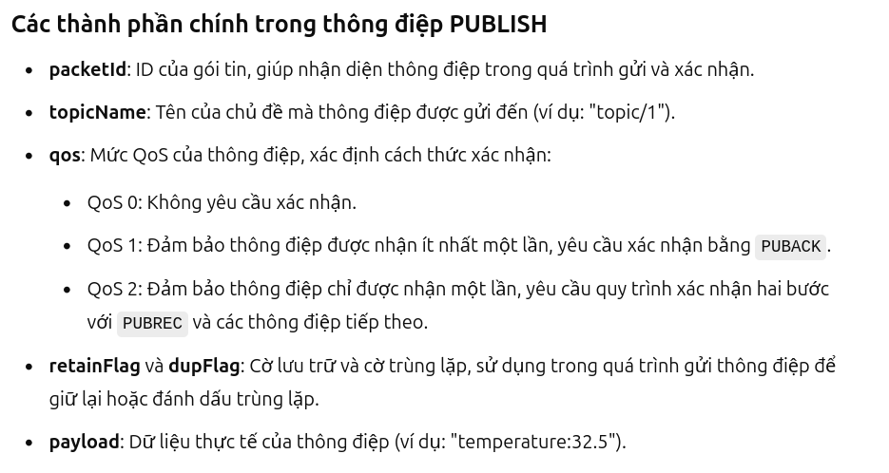
MQTT Message flow - PUBLISH
Broker
Client 2

Slide 18
MQTT Message flow - PUBLISH
Broker
Client 2

Slide 19

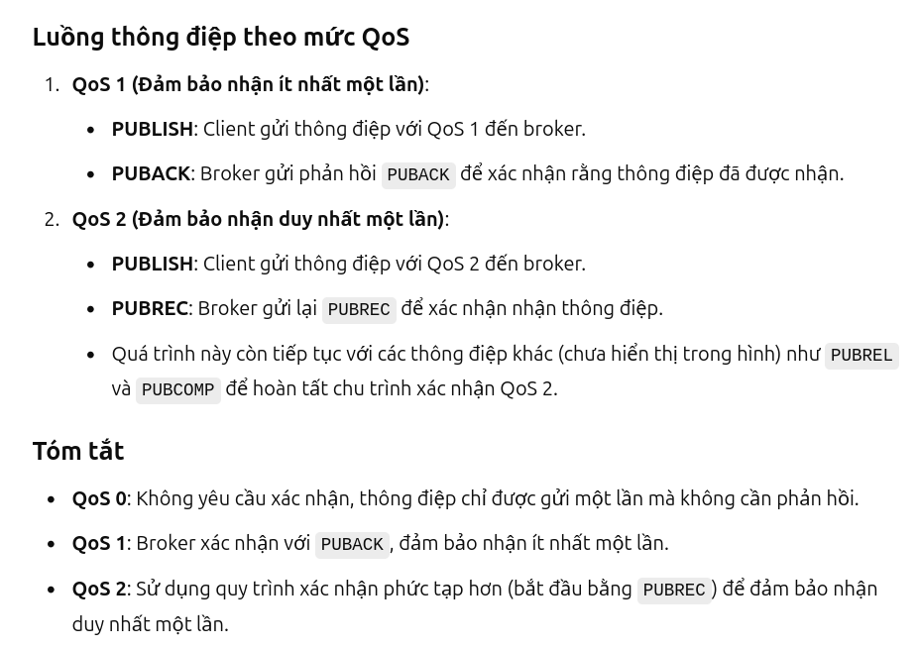

Slide 20
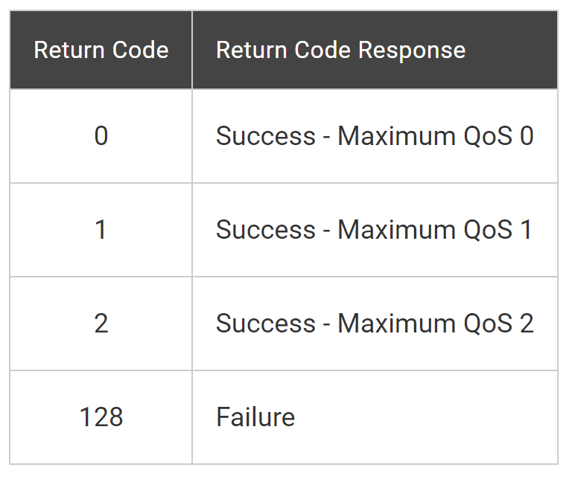
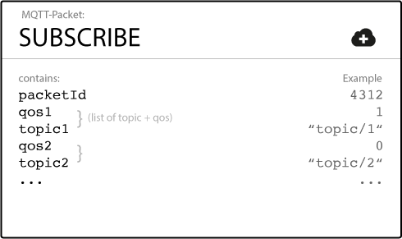
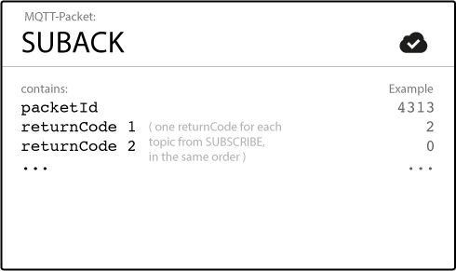

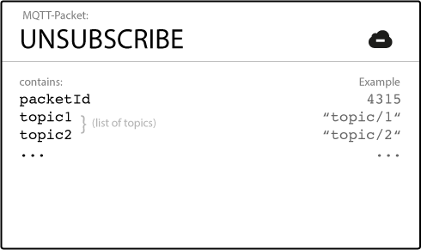
MQTT Message flow
Client 1
Broker
CONNECT
CONNACK
SUBSCRIBE
SUBACK
UNSUBSCRIBE
UNSUBACK

Slide 21
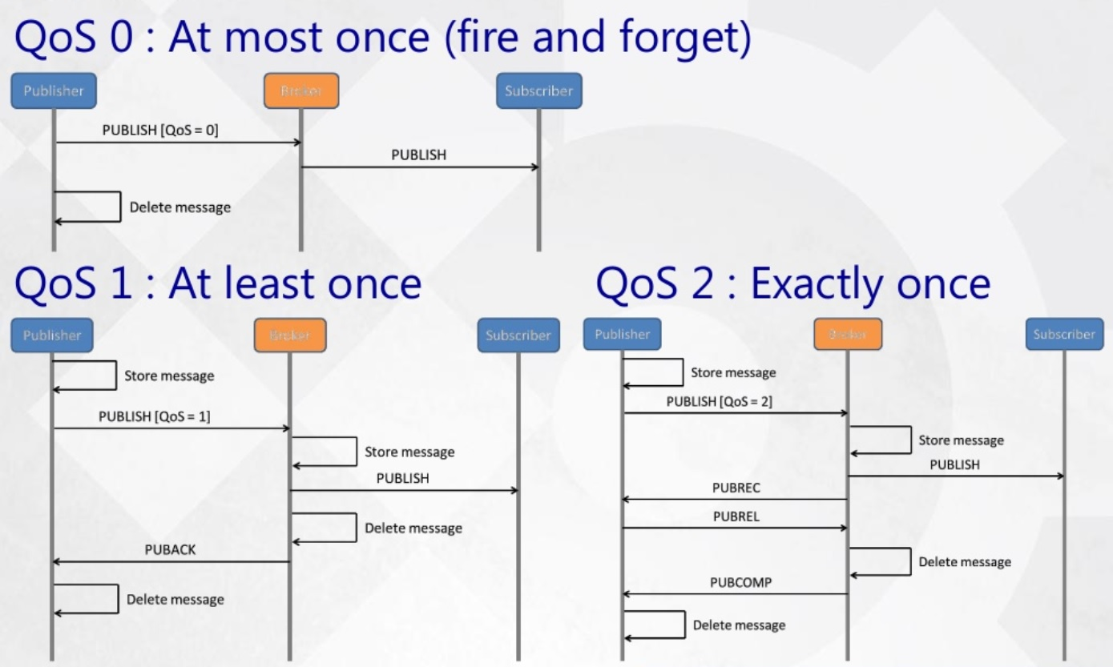
QoS – Quality of service

Slide 22
Setup MQTT Platform
MQTT Broker:
Online Broker:
Paid: Amazon Azure, Google Cloud, IBM Cloud
“Free”: Eclipse, Mosquitto, Hivemq, emqx.io, Flespi…
On PC Broker: Mosquitto
https://mosquitto.org/
MQTT Client library:
Eclipse Paho - https://www.eclipse.org/paho/
Notes: compile code C with “-lpaho-mqtt3c”
e.g. gcc pub.c -o pub -lpaho-mqtt3c

Slide 23
Install Paho-MQTT
sudo apt update
git clone https://github.com/eclipse/paho.mqtt.c.git
cd paho.mqtt.c
sudo apt install libssl-dev
make
sudo make install

